Slide 1


Air Trajectory
[Division B/C]
Georgia Tech Event Workshop Series 2024-25

Slide 2
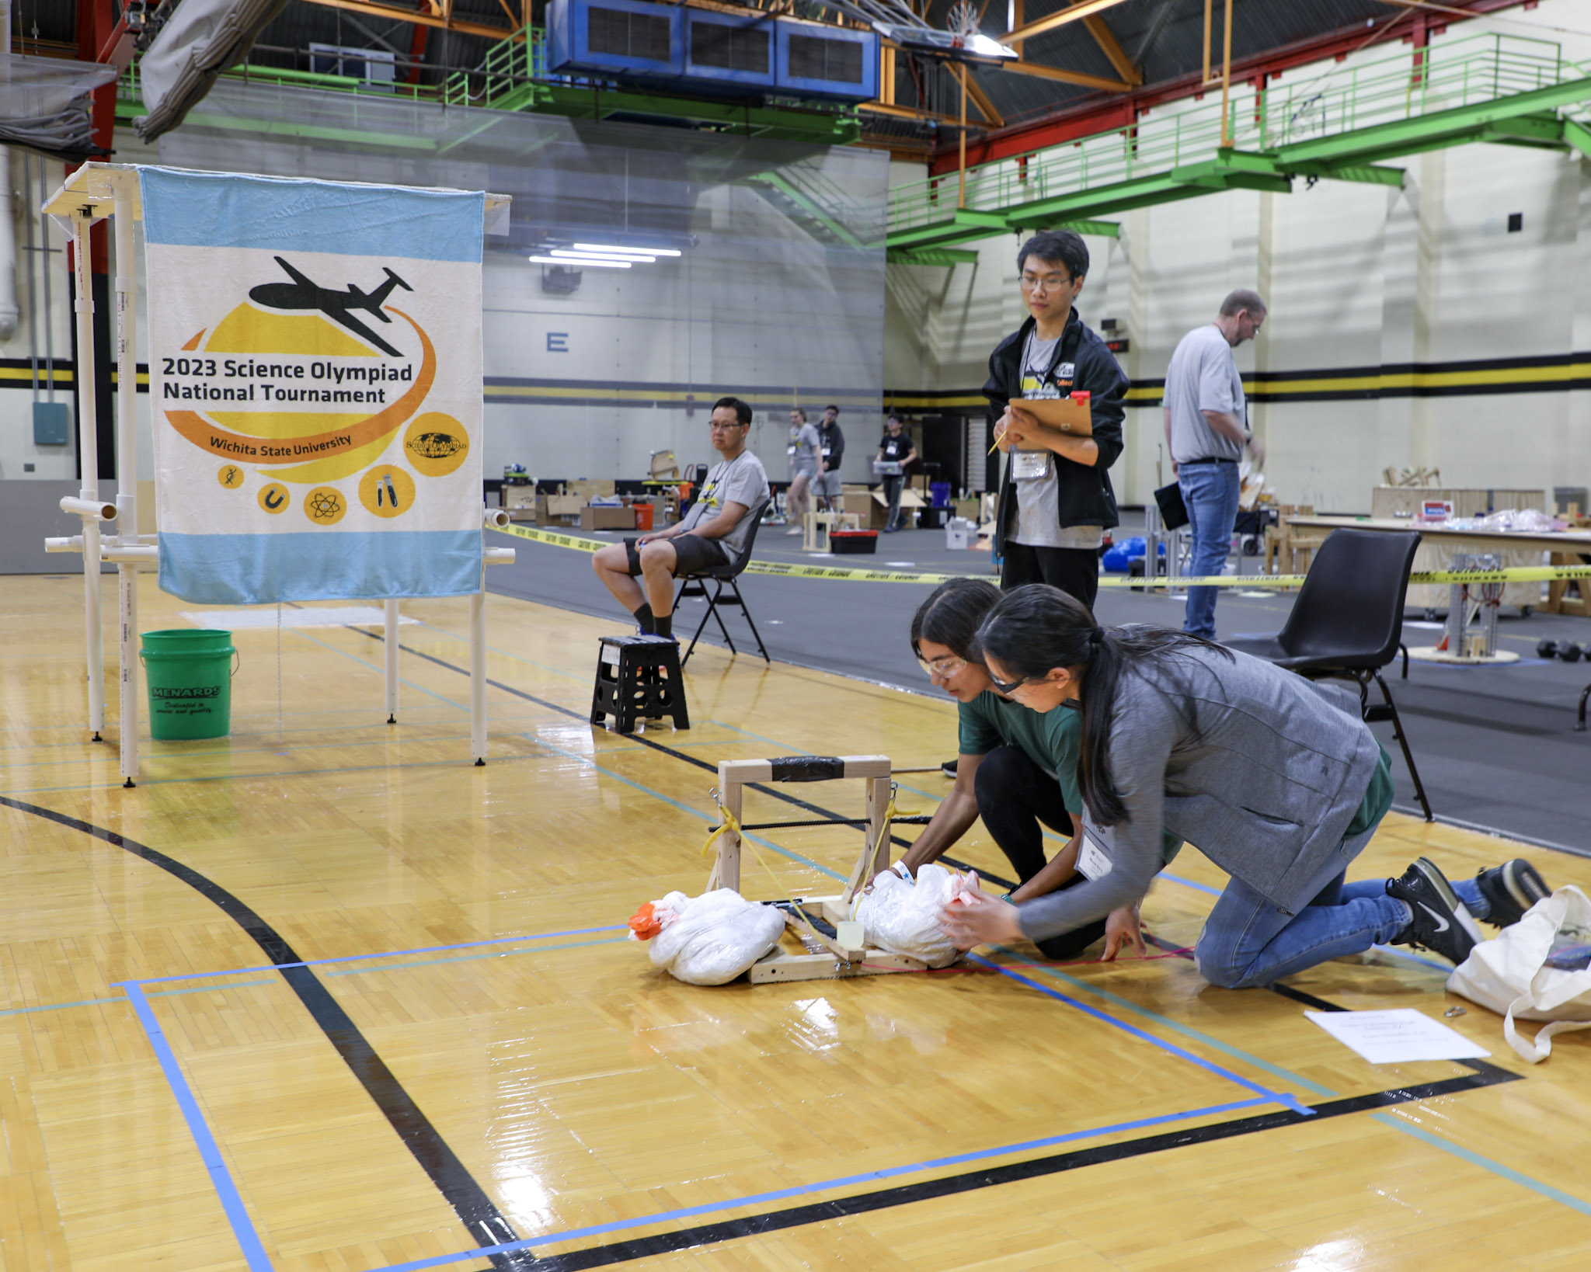
01
RULES SHEET
02
DIFFICULT TOPICS
03
TIPS FROM A VETERAN
04
OTHER FREE RESOURCES
Notes:
For Builds: Replace difficult topics with physical principles involved in the build and replace common questions with common designs

Slide 3
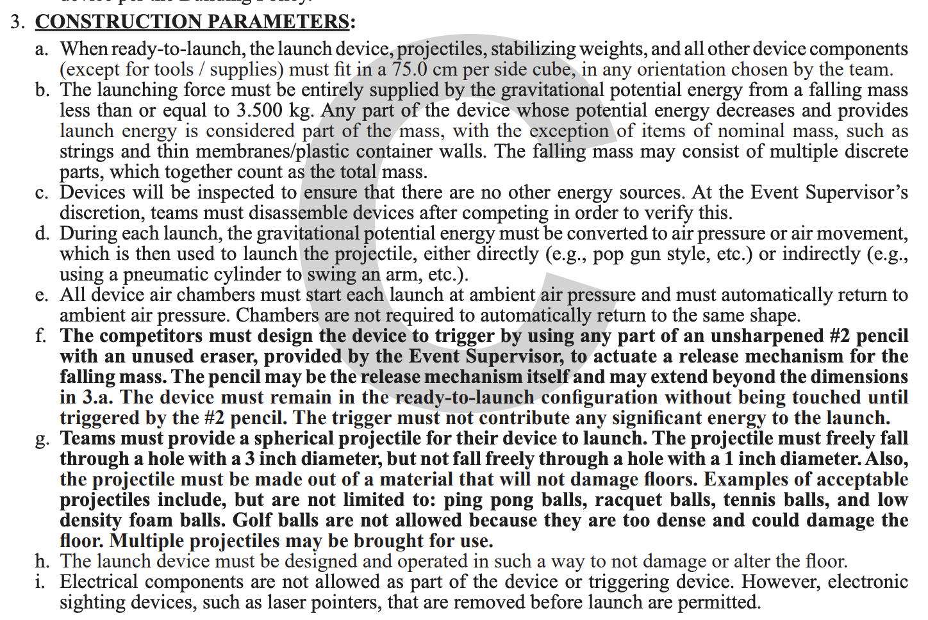
The Rules Sheet
Basically have these memorized. Meet these criteria at all costs even if the device doesn’t do what you want it to. Getting tiered is extremely detrimental.
Ping pong balls are usually the most effective projectiles because of their light weight.
Make sure the device is able to be released using a pencil and fits the dimensions.
Notes:
Highlight key points from the rules sheet: DESIGN LOGS that basically grant free points, most tested-on topics, point distribution so that competitors know what to prioritize, allowed notes and equipment, etc.

Slide 4
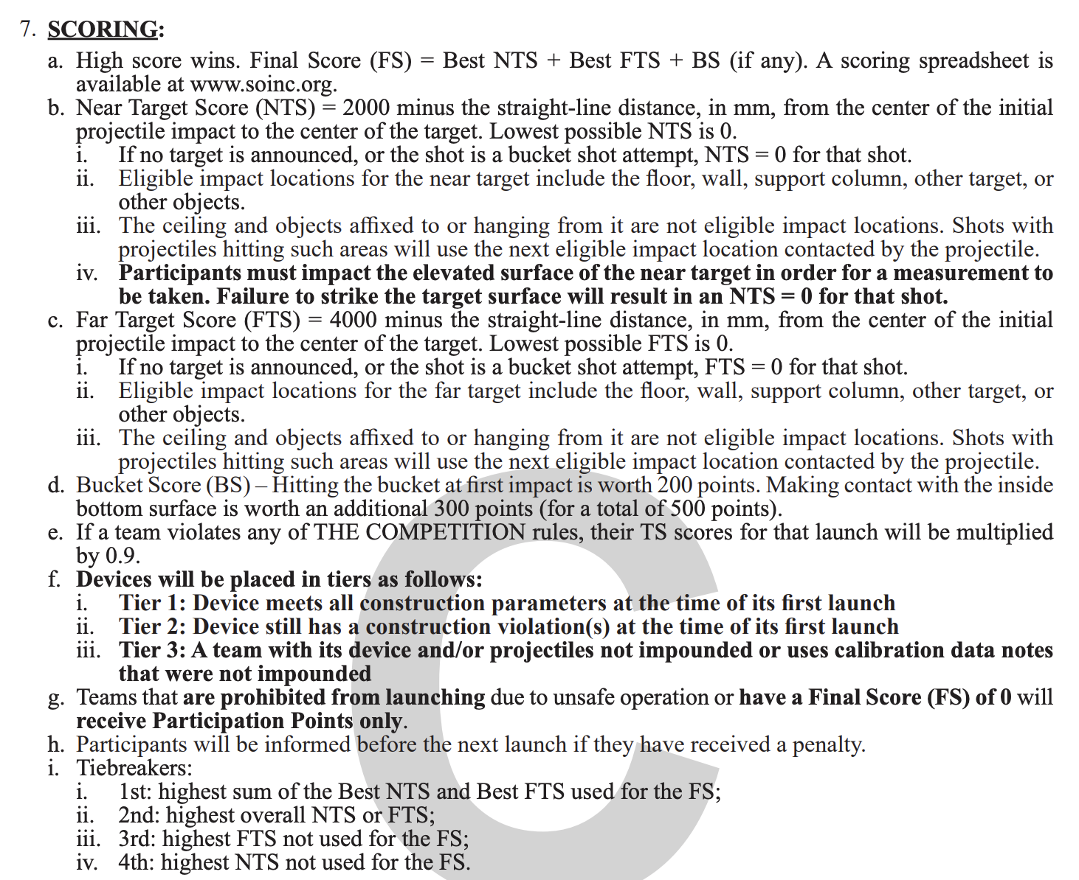
Scoring
Far Target is significantly more lucrative than Near Target.
Prioritize making a launcher that is physically capable of shooting a ball that far before tuning and testing.
Bucket points should not be a priority until the rest of the points are extremely consistent.
Notes:
Highlight key points from the rules sheet: DESIGN LOGS that basically grant free points, most tested-on topics, point distribution so that competitors know what to prioritize, allowed notes and equipment, etc.

Slide 5

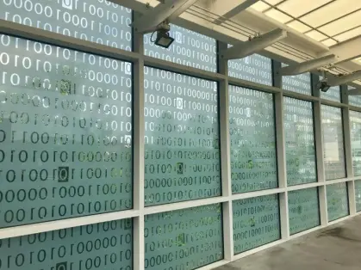
DIFFICULT TOPICS
Notes:
This section should focus on topics that are more math-based (harder to self-teach), concepts that come only usually up in college level courses, or concepts that you struggled with when you competed in this event

Slide 6
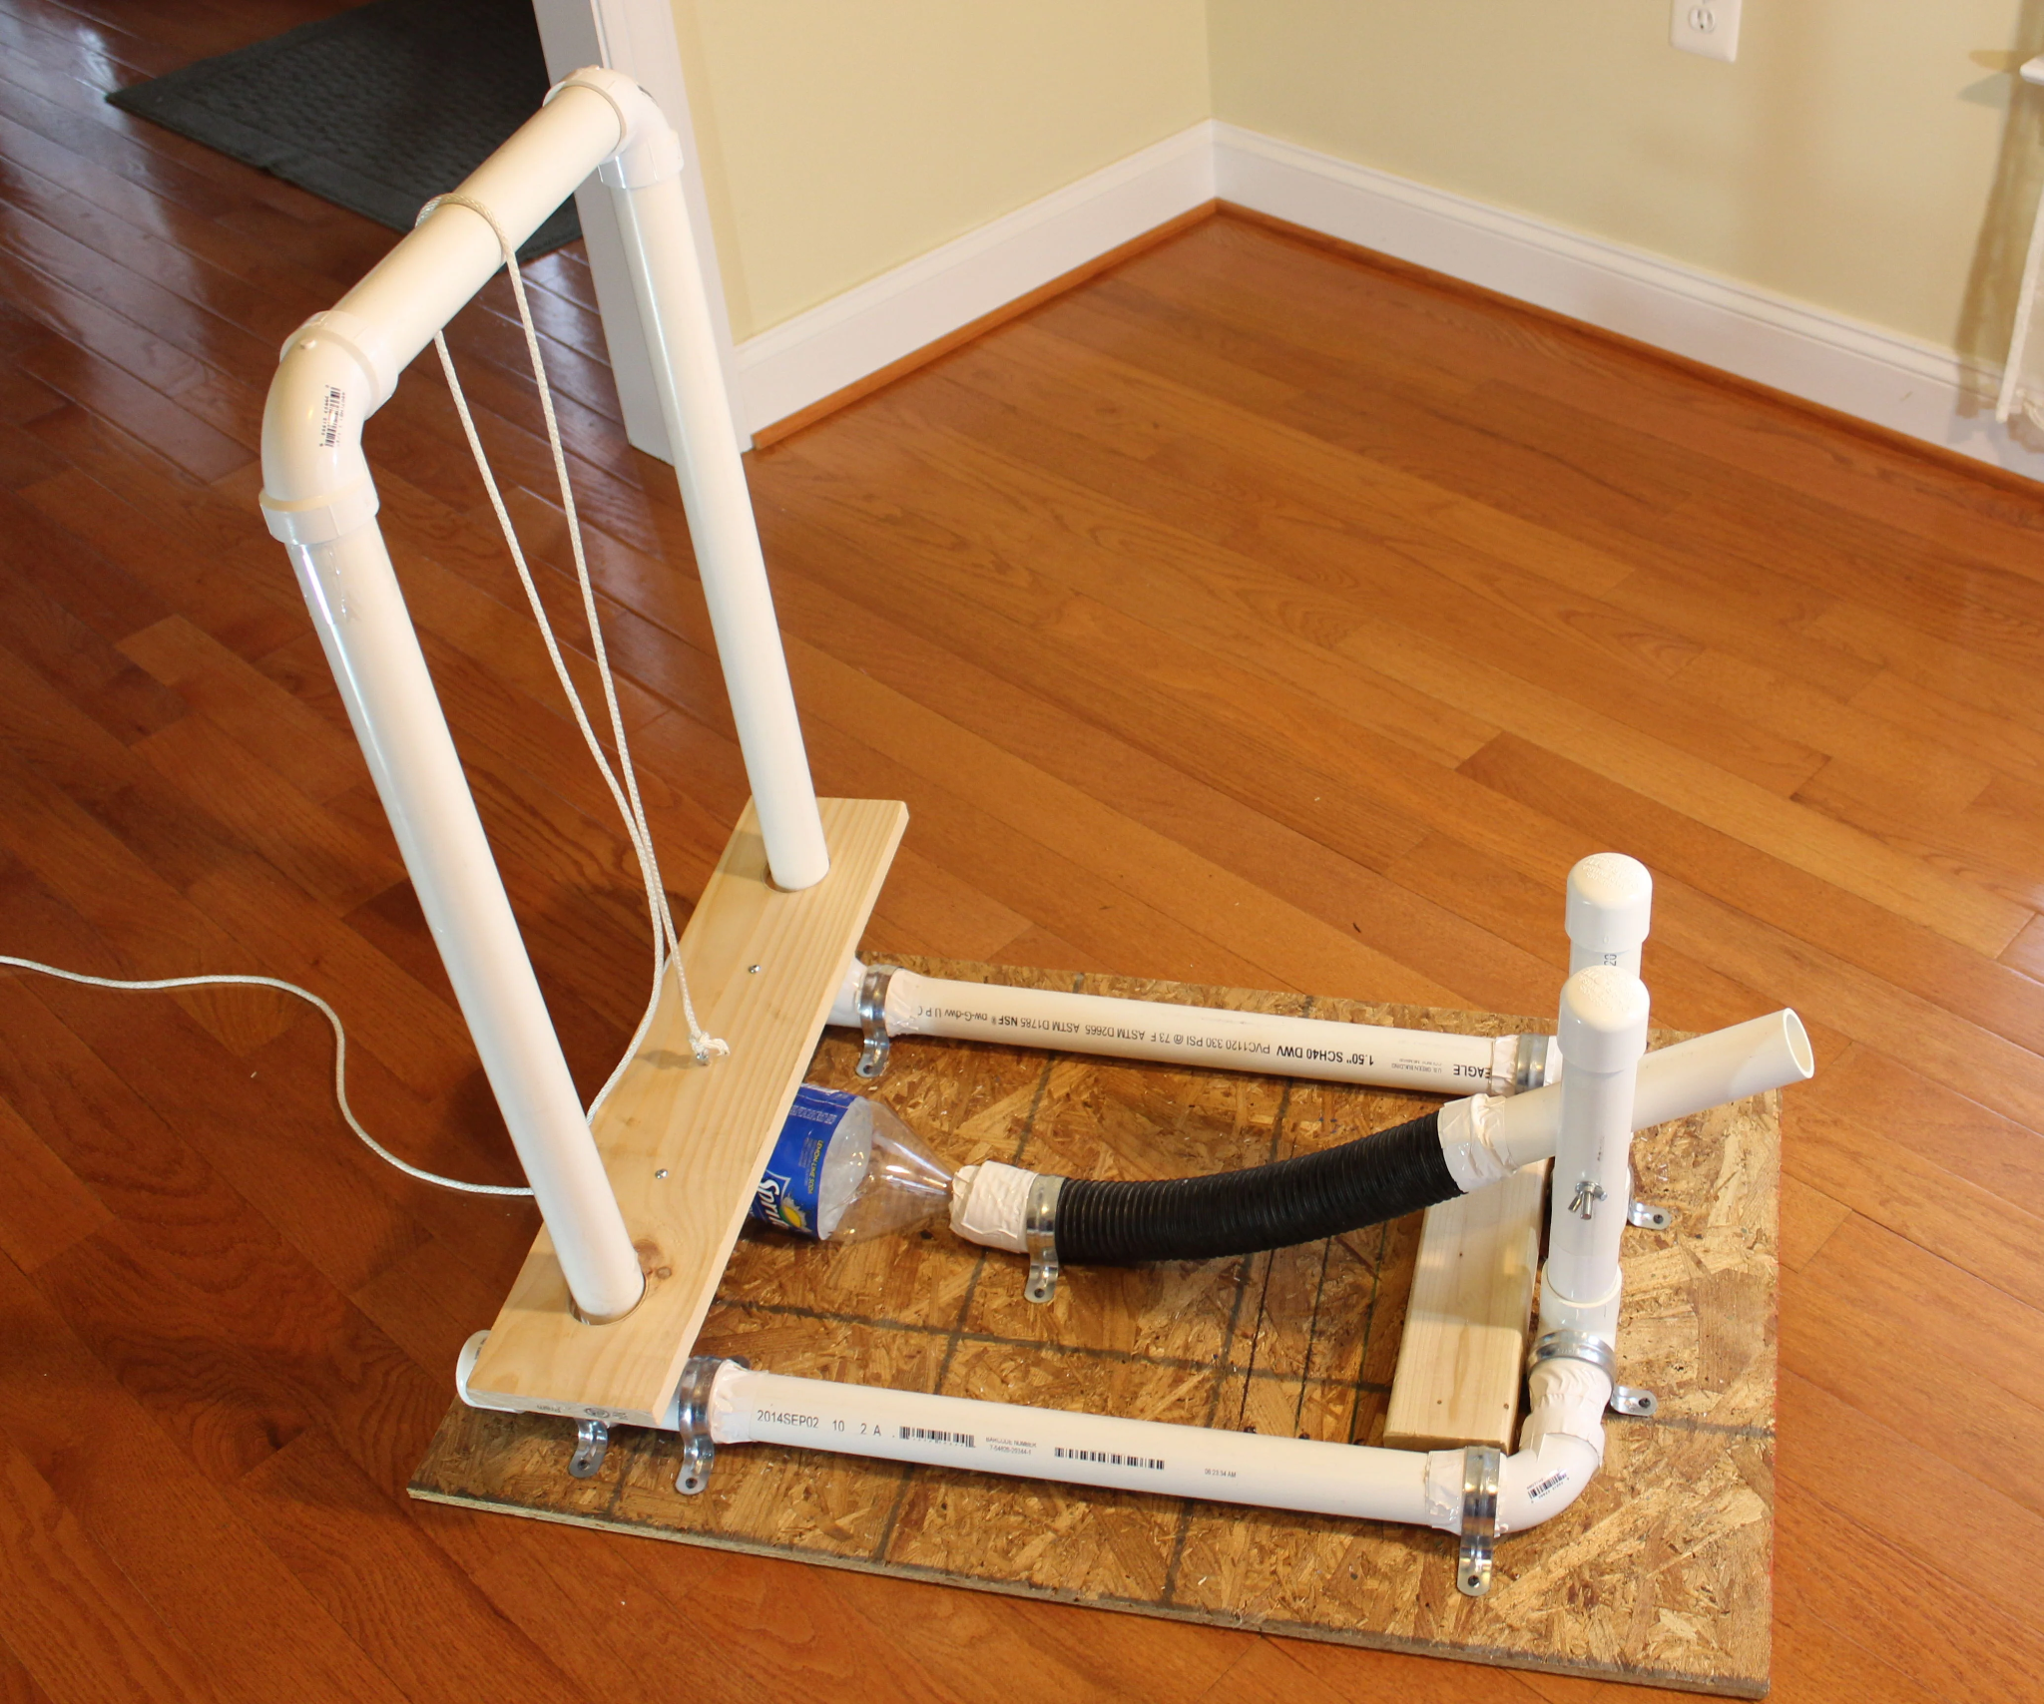
Topic 1: Goals
Prioritize consistency and basic capability
Minimize changed variables between trials as much as possible to isolate independent variables
Design on the right
Pros
Good starter design
Realistic for a first competition
Easy materials
Cons
Lots of possible variation

Slide 7
Topic 2: Consistency
Have as many measurable things as possible.
For example:
Angle of launch
Angle of platform
Height of dropped weight
Change measurements to reach as many distances as you can
I usually start with increments of 0.5m and half the increments each time I go through them all
Make logs and tweak as many variables as you possibly can, recording everything.
Elevation and angles might change because of rules
The more data you have, the more you can extrapolate
Only after you have the bare-minimum. Have a device that can go the full distance first before working on achieving all the distances in between.

Slide 8
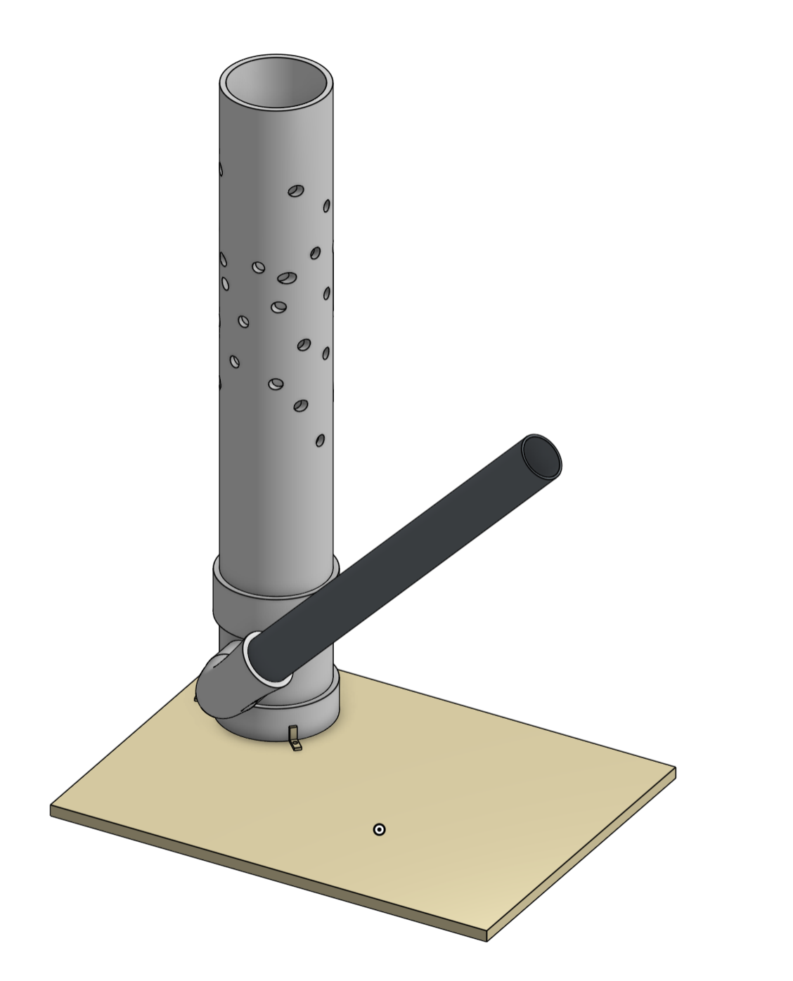
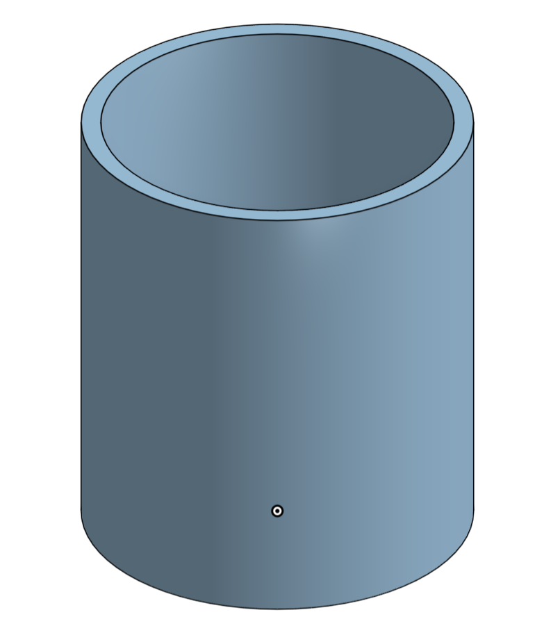
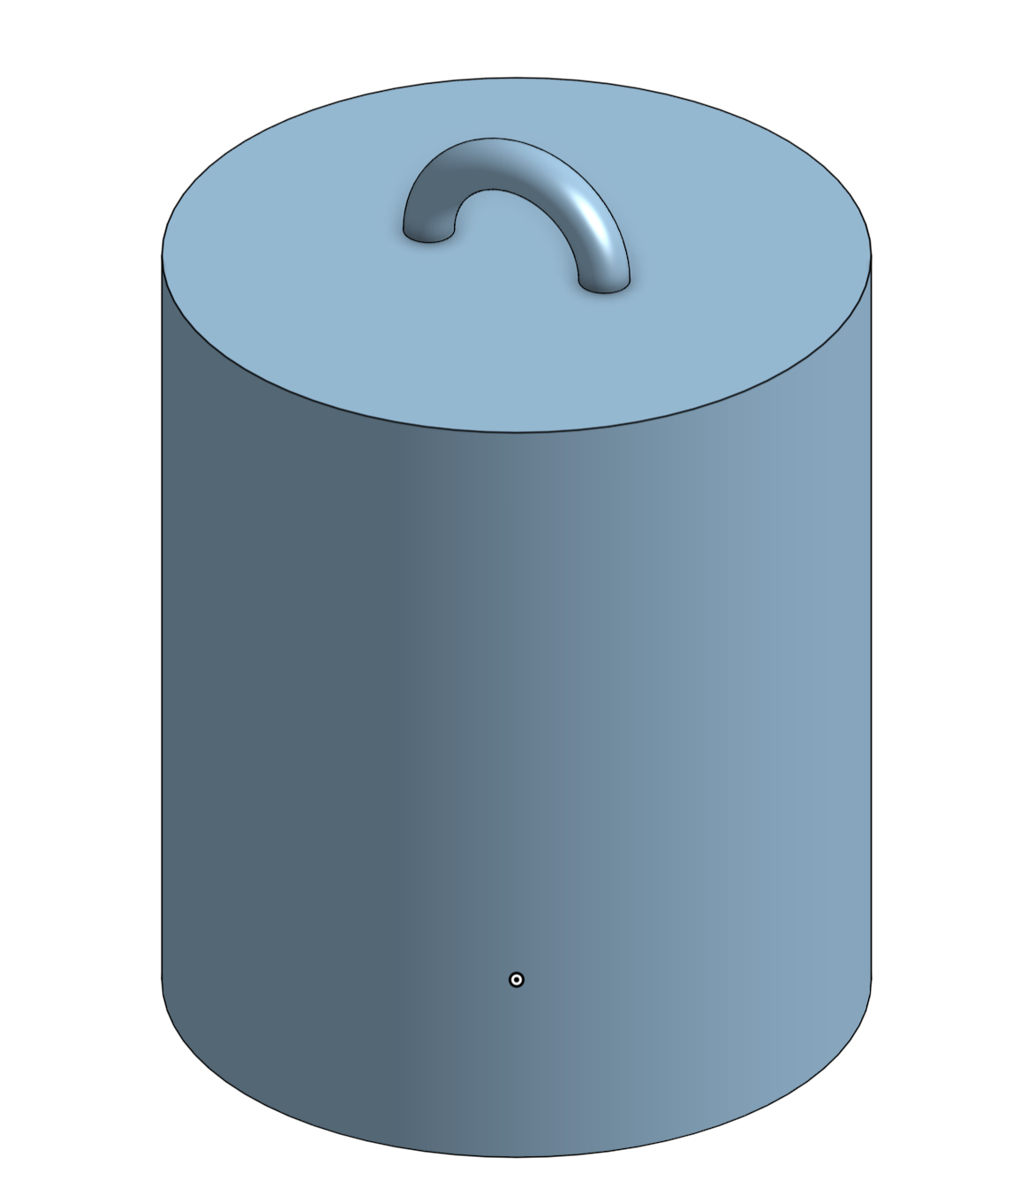
Topic 3: Late-Stage
Benefits:
Consistent placement of holes generating consistent amounts of force
Accurate and measurable launch angle.
Cons:
Time consuming to build and acquire all materials for and do all testing.
3D Printed Cylindrical Weight
- filled with small metal balls
- very compact and consistent
- sanded down to be as airtight as possible
Notes:
Feel free to add more topics and make sure that there are plenty of pictures/diagrams!

Slide 9
Tips from a Veteran
Prioritize consistency above everything else
Collect as much information about your device as possible before competitions
Logs
Measurements
Make sure it meets rules requirements
Do NOT get tiered.
Make sure you know what is realistic for your timeline
Get inspired by other designs and whatever you think you can make consistent
Notes:
Use this section to talk about any strategies you used to navigate the event when you competed. For example, how did you manage your time, how did you organize your notes, how did you split topics up between you and your partner, etc.?

Slide 10
Additional Resources
Youtube Tutorial
Tutorial for the initial early-stage design I showed in this presentation
OnShape
Free 3D Modeling software, easy to learn, no download needed.
Notes:
Here, you can link or mention any online or book resources that helped you in this event when you were a competitor. Try to avoid general resources like scioly wiki, because they probably already are familiar with it.

Slide 11
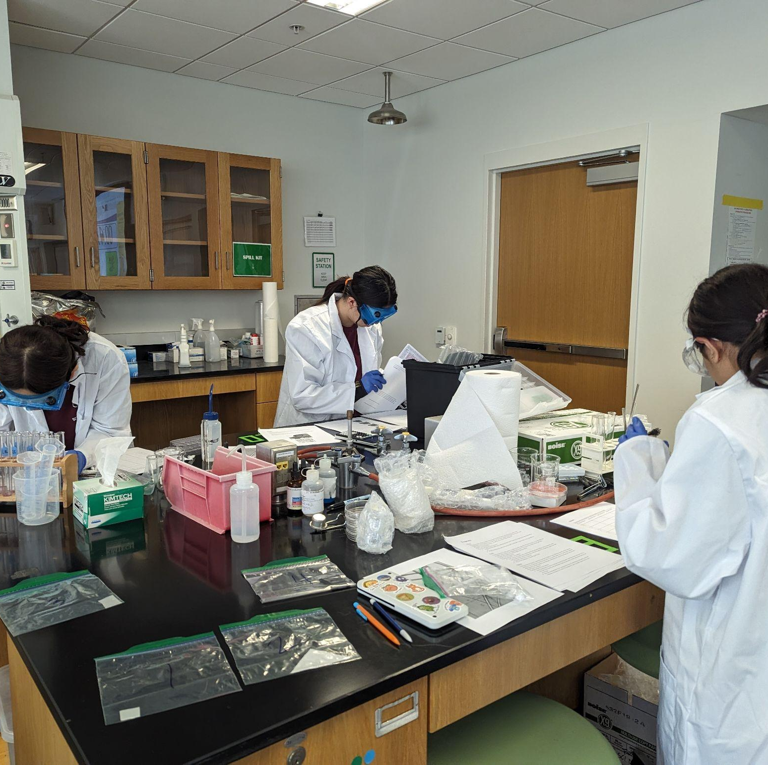
THANKS!
Notes:
(replace picture with a picture from one of our tournaments)

